Slide 1
One-v-set extension to libsvM
one-v-set alg. based on "1-vs-all" binary SVMs

Slide 2
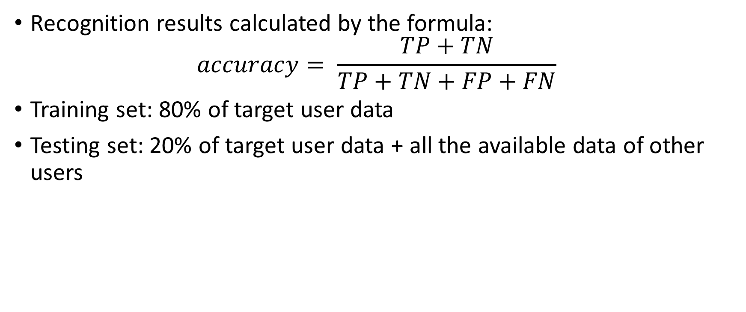
Original one-class SVM
Recognition results calculated by the formula: $accuracy= \frac{TP+TN}{TP+TN+FP+FN}$
Training set: 80% of target user data
Testing set: 20% of target user data + all the available data of other users

Slide 3
Results Filtered data
 | user1 | user2 | user3 | user4 | user5 | user6
Jogging | 0.53 | 0.51 | 0.41 | 0.45 | 0.42 | 0.60
Running | 0.45 | 0.44 | 0.45 | 0.42 | 0.50 | 0.43
Walking down-stairs | 0.46 | 0.51 | 0.47 | 0.50 | 0.50 | 0.45
Walking up-stairs | 0.45 | 0.51 | 0.49 | 0.62 | 0.50 | 0.55
Walking | 0.54 | 0.45 | 0.40 | 0.52 | 0.48 | 0.49
Overall accuracy | 0,49 | 0,48 | 0,44 | 0,5 | 0,48 | 0,5

Slide 4
Binary 1-vs-set SVM
Training set: 50% of target user data + 20% of some other user data
Testing set: 50% of target user data + 80% of the rest data from the training negative class+ all the available data of other users

Slide 5
Results Filtered data (accuracy, %)
 | user1 | user2 | user3 | user4 | user5 | user6
Jogging | 67.6 | 44.8 | 40.1 | 39.3 | 47.8 | 83.9
Running | 65 | 66.2 | 41.8 | 52.4 | 55.9 | 76.1
Walking down-stairs | 60 | 67.6 | 62.1 | 75.4 | 61.2 | 80.8
Walking up-stairs | 60.9 | 67 | 64.5 | 82.8 | 62 | 82.1
Walking | 69.6 | 73.6 | 63.7 | 66.1 | 62.2 | 82.1
Overall accuracy | 64.7 | 63.8 | 54.4 | 63.2 | 57.8 | 81

Slide 6
Binary 1-vs-set SVM
Training set: 50% of target user data, divided on two parts: 80% marked as positives, 20% marked as negatives
Testing set: 50% of target user data + all the available data of other users

Slide 7
Results Filtered data (accuracy, %)
 | user1 | user2 | user3 | user4 | user5 | user6
Jogging | 9.8 | 26.6 | 12.8 | 7.8 | 11 | 28.6
Running | 45.4 | 46.3 | 10.2 | 7.7 | 53.7 | 39.8
Walking down-stairs | 6 | 67.7 | 11.9 | 12.8 | 5.4 | 44.1
Walking up-stairs | 13.2 | 18.8 | 20.4 | 55.6 | 62 | 7.1
Walking | 63 | 73.8 | 5.8 | 70.5 | 77.1 | 10.1
Overall accuracy | 27.5 | 46.6 | 12.2 | 30.9 | 41.8 | 25.9

Slide 8
One-class 1-vs-set SVM
Training set: 50% of target user data
Testing set: 50% of target user data + all the available data of other users

Slide 9
Results Filtered data (accuracy, %)
 | user1 | user2 | user3 | user4 | user5 | user6
Jogging | 78.1 | 70.2 | 20.7 | 46.1 | 29.1 | 62.4
Running | 21.5 | 75 | 12.5 | 73.6 | 38.1 | 69.4
Walking down-stairs | 91.5 | 87.5 | 90.5 | 87.4 | 92 | 84
Walking up-stairs | 89.9 | 89.0 | 90.6 | 90 | 91.9 | 84.1
Walking | 90.4 | 90.2 | 90.2 | 89.9 | 89.6 | 85
Overall accuracy | 74.3 | 82.4 | 60.9 | 77.4 | 68.1 | 60.3

Slide 10
Original one-class SVM, deep AE
Training set: 80% of target user data
Testing set: 20% of target user data + all the available data of other users

Slide 11
Results
 | user1 | user2 | user3 | user4 | user5 | user6
Jogging | 0.83 | 0.72 | 0.74 | 0.77 | 0.79 | 0.73
Running | 0.96 | 0.97 | 0.96 | 0.97 | 0.98 | 0.95
Walking down-stairs | 0.98 | 0.95 | 0.97 | 0.97 | 0.98 | 0.92
Walking up-stairs | 0.91 | 0.95 | 0.96 | 0.97 | 0.98 | 0.90
Walking | 0.77 | 0.75 | 0.74 | 0.68 | 0.74 | 0.72
Overall accuracy | 0,89 | 0,87 | 0,87 | 0,87 | 0,89 | 0,84

Slide 12
One-class 1-vs-set SVM, deep AE
Training set: 50% of target user data
Testing set: 50% of target user data + all the available data of other users

Slide 13
Results
 | user1 | user2 | user3 | user4 | user5 | user6
Jogging | 97.58 | 96.22 | 96.72 | 97.32 | 99.54 | 97.27
Running | 90.49 | 92.8 | 90.56 | 91.98 | 92.42 | 89.37
Walking down-stairs | 93.01 | 90.15 | 91.8 | 90.56 | 93.13 | 89.7
Walking up-stairs | 91.19 | 90.02 | 91.28 | 91.91 | 92.85 | 96.18
Walking | 95.17 | 100 | 94.66 | 99.95 | 99.52 | 95.77
Overall accuracy | 93.49 | 93.84 | 93 | 94.34 | 95.49 | 93.66

Slide 14
Original one-class SVM, deep denoising AE
Training set: 80% of target user data
Testing set: 20% of target user data + all the available data of other users

Slide 15
Results
 | user1 | user2 | user3 | user4 | user5 | user6
Jogging | 0.99 | 0.87 | 0.91 | 0.97 | 0.98 | 0.95
Running | 0.93 | 0.94 | 0.95 | 0.98 | 0.99 | 0.87
Walking down-stairs | 0.89 | 0.97 | 0.88 | 0.99 | 0.95 | 0.99
Walking up-stairs | 0.91 | 0.77 | 0.96 | 0.93 | 0.98 | 0.95
Walking | 0.98 | 0.93 | 0.96 | 0.99 | 0.97 | 0.80
Overall accuracy | 0,94 | 0,9 | 0,93 | 0,97 | 0,97 | 0,91

Slide 16
One-class 1-vs-set SVM, deep denoising AE
Training set: 50% of target user data
Testing set: 50% of target user data + all the available data of other users

Slide 17
Results
 | user1 | user2 | user3 | user4 | user5 | user6
Jogging | 97.82 | 99.89 | 99.92 | 99.52 | 100 | 99.19
Running | 94.29 | 99.58 | 99.24 | 97 | 99.34 | 99.9
Walking down-stairs | 99.34 | 93.93 | 99.73 | 99.73 | 99.74 | 96.15
Walking up-stairs | 99.47 | 96.08 | 97.23 | 98.61 | 97.47 | 95.56
Walking | 97.96 | 99.47 | 98.62 | 98.39 | 99.91 | 97.23
Overall accuracy | 97.78 | 97.79 | 98.95 | 98.65 | 99.29 | 97.61

